Slide 1


Using a Shiny App in Public Health research
Jaime Villacampa and Andrew Baxter

Slide 2
What is Shiny?
A package that makes interactive websites.
Translates R code into web code: HTML, CSS and JavaScript.
Works well with data.

Slide 3
Why use Shiny?
Price
Flexibility
Potential
Public engagement
Reproducibility and open research

Slide 4
Why use Shiny?
Advantages
Disadvantages
Mapping and modelling
Extremely flexible
Develop a new skill set
Potentially not widely used in your organisation
Easy for public-facing data, not as easy for confidential information
Time for development

Slide 5
Differences from normal R code
Code divided in three parts: global, ui and server
The code can respond to user input
Ability to integrate CSS/HTML/Javascript
Differences in the order of things run

Slide 6
The key building blocks
The User Interface
ui.R
`*Input(inputId = "a")` - passes input "a" to server
… layout/structure of ui …
`*Output(outputId = "b")` - gets output "b" from server
The server
server.R
`input$a` - gets input "a" from ui
… R code processes …
`output$b <- render*(...)` - passes output "b" to ui

Slide 7
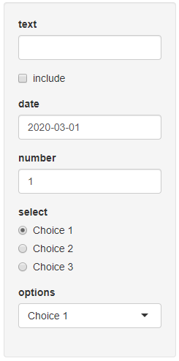
Input functions - examples
Input in ui.R
input$id in server.R
textInput()
checkboxInput()
numericInput()
radioButtons()
selectInput()
String
Logical
Numeric
String – chosen option
R()

Slide 8
Output functions - examples
Rendered in server.R
Outputted in ui.R
output$x <- renderText()
output$y <- renderPlot()
output$z <- renderDataTable()
textOutput(outputId = 'x')
plotOutput(outputId = 'y')
dataTableOutput(outputId = 'z')

Slide 9
Output functions - examples
Rendered in server.R
Outputted in ui.R
output$x <- renderText()
output$y <- renderPlot()
output$z <- renderDataTable()
textOutput(outputId = 'x')
plotOutput(outputId = 'y')
dataTableOutput(outputId = 'z')
R()

Slide 10
Passing and processing
ui.R
server.R
ui.R
intypeInput(
InputId = "a", ...
),
output$x <- renderOuttype(
func(input$a, ...)
)
outtypeOutput(
outputId = "x"
),

Slide 11
Multiple inputs
ui.R
server.R
ui.R
intypeInput(
InputId = "a", ...
),
output$x <- renderOuttype(
func(input$a, input$b, ...)
)
outtypeOutput(
outputId = "x"
),
intypeInput(
InputId = "b", ...
),
R()

Slide 12
ui.R
server.R
ui.R
outtype1Output(
outputId = "x"
),
intypeInput(
InputId = "a", ...
),
???
outtype2Output(
outputId = "y"
),

Slide 13
The reactive() element
ui.R
server.R
ui.R
output$x <- renderOuttype1(
func(df(), ...)
)
outtype1Output(
outputId = "x"
),
df <- reactive(
func(input$a)
)
intypeInput(
InputId = "a", ...
),
output$y <- renderOuttype2(
func(df(), ...)
)
outtype2Output(
outputId = "y"
),
R()

Slide 14
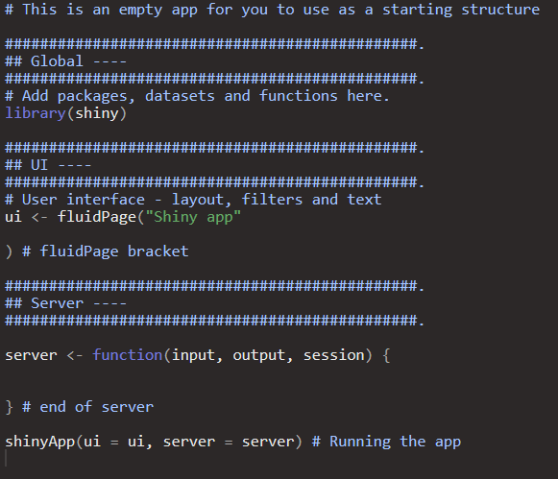
How this translates into “action”?

Slide 15
How to publish an app
shinyapps.io cloud server: https://www.shinyapps.io/
Shiny Server: https://rstudio.com/products/shiny/shiny-server/
Shiny Proxy: https://www.shinyproxy.io/
Server-less option

Slide 16
There is more than code to Shiny
Version control
User testing, over and over
Different skill set: design, visual, creative

Slide 17
Add-ons/customization
Lots of options to customise your app, some easier than others:
Packages: shinyWidgets, shinythemes and shinycssloaders-
Packages: shinyjs, shinyBS
Create your own HTML, CSS or JavaScript

Slide 18
Gallery of apps
There are many examples of Shiny apps presenting public health data.A good place to start looking for examples is the official gallery: https://shiny.rstudio.com/gallery/
Socioeconomic inequalities in health in Scotland: https://mirjamallik.shinyapps.io/SIH_ethnicity/
ScotPHO profiles tool: https://scotland.shinyapps.io/ScotPHO_profiles_tool/ https://github.com/ScotPHO/scotpho-profiles-tool
Scottish burden of disease: https://scotland.shinyapps.io/scotpho-burden-disease/
COVID-19 wider impacts on health: https://scotland.shinyapps.io/phs-covid-wider-impact/ https://github.com/Health-SocialCare-Scotland/covid-wider-impact

Slide 19
Useful resources
We have created a list of useful resources to help with Shiny here: https://github.com/ScotPHO/r-pubhealth-workshop/wiki/Useful-resources

Slide 20
Exercises
The dataset we are going to use is based on Census data.
It includes standardizes rates on self-rated health for different ethnicities split by age group and SIMD deprivation quintile.
The standardizes rates refer to two measures of self-rated health: poor general health and limiting long-term illness.
Everything calculated, try to do most of your calculations outside Shiny to speed up your app.
https://github.com/ScotPHO/r-pubhealth-workshop/wiki

